Slide 1
Webdev project eXi@Store
LOUMEAU Alexis
CAUCHARD Nicolas
SABOURDY Vincent
MALLEA Cyprien
TEXEREAU Alexis

Slide 2
Summary
Introduction
Organization
Conception
Demonstration
Conclusion
Question

Slide 3
Introduction:
We have been asked to develop an e-shopping website for eXi@Store.

Slide 4
Specs:
Register and login
Basket for storing chosen products
Searching function
Display of proposed products
Using PDO and MVC model
Administration interface
Responsive designed website
Order management

Slide 5
Organization:
LOUMEAU Alexis
Project manager
CAUCHARD Nicolas
Back-End developer
TEXEREAU Alexis
SQL/Database developer
MALLEA Cyprien
HTML/CSS developer
SABOURDY Vincent
Front-End developer

Slide 6
Organization:
Front-End
Back-End
HTML/CSS
SQL/Database
Functions:
Register
Connection
Basket
Payment
Functions:
Manage orders
Manage customers
Manage catalog
Display:
Responsive design
Friendly-user Interface
Manage:
Database

Slide 7






Sublime Text 3
Notepad++
WAMP
PowerAMC
Microsoft Project
Balasmiq

Slide 8
Conception:
Mockups
MCD

Slide 9
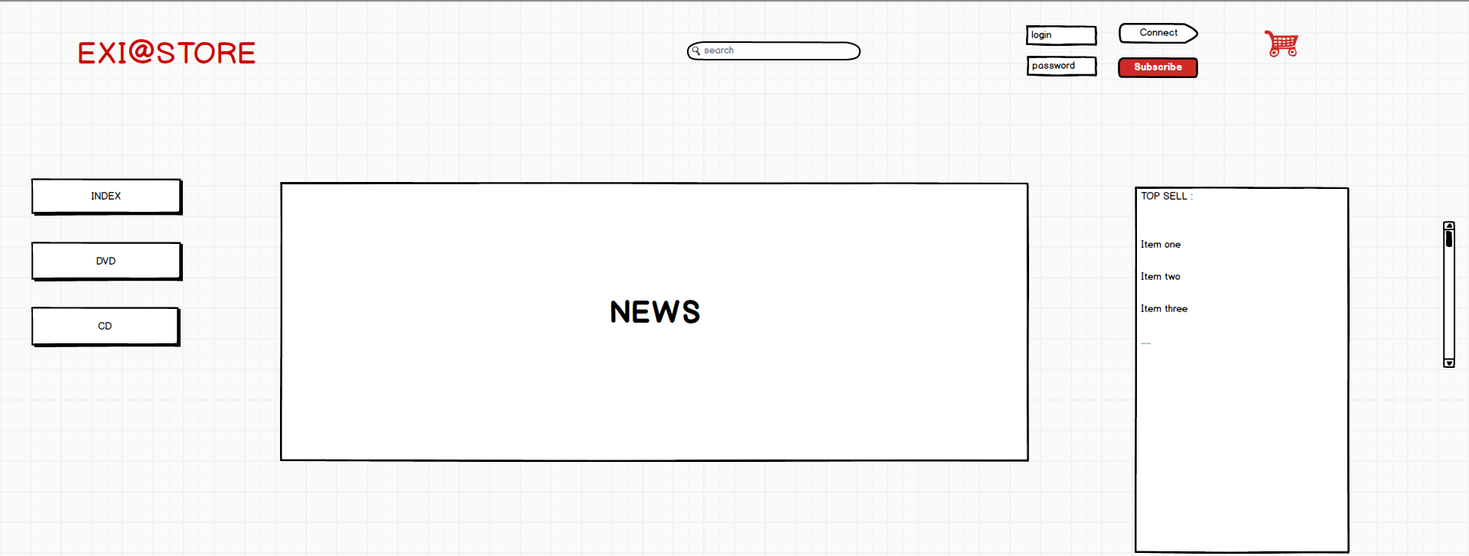
Mockups:
Main page:

Slide 10
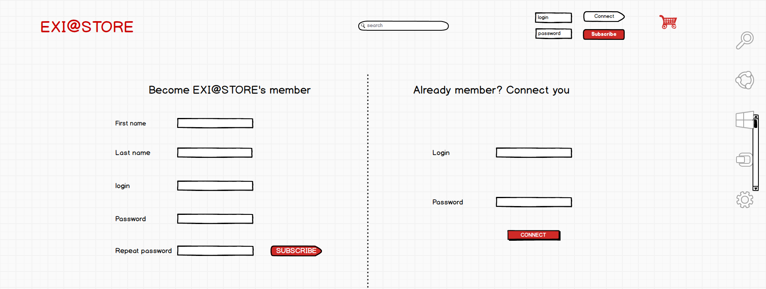
Login/register view:

Slide 11
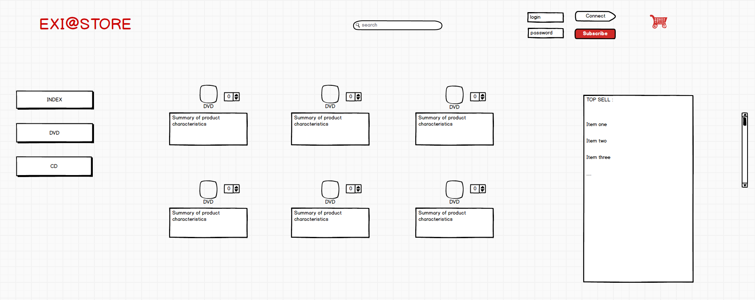
Products display:

Slide 12
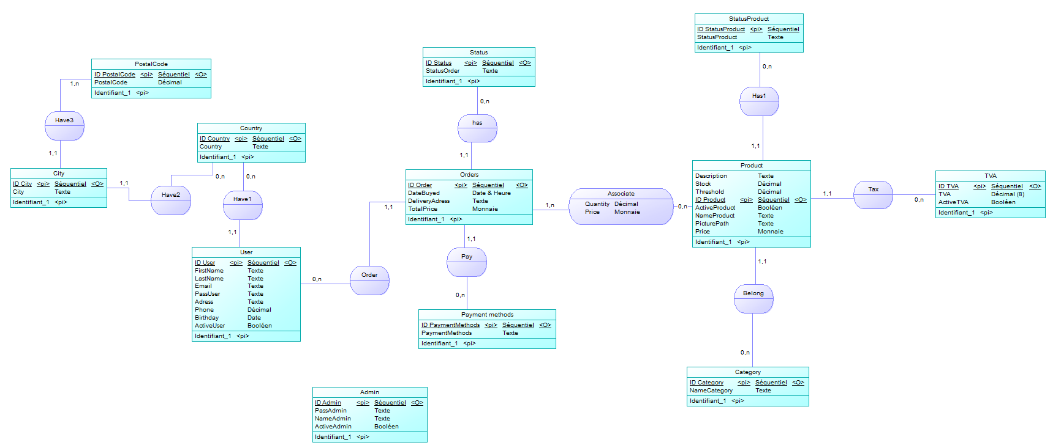
MCD:

Slide 13
Conclusion:
Deviations:
Displaying products
Payment process
Missing dynamic HTML

Slide 14
Questions?

